Slide 1
Pollution Effect and Solution
Bhaveshkumar Parmar​

Slide 2
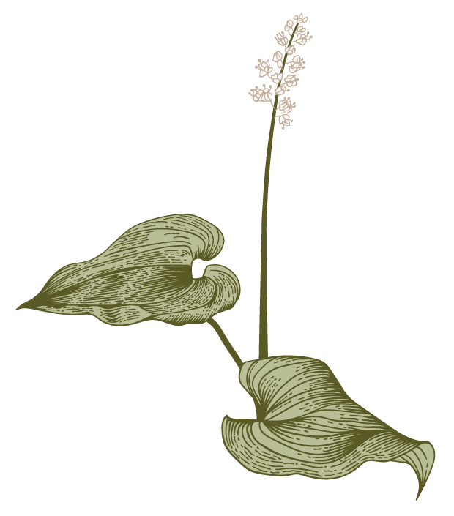

Agenda
A
Definition
Types
Effects and Damages
Solution
Conclusion

Slide 3
Definition
Pollution is when harmful stuff gets into our air, water, or soil, making it dirty or unsafe for living things, including us. It can come from factories, cars, trash, and more.
Pollution is harmful stuff gets into the environment and makes things dirty or unhealthy.

Slide 4
Types
Here are some types of pollution
Air Pollution
Water Pollution
Soil Pollution
Noise Pollution
Pollution Effect and Solution

Slide 5
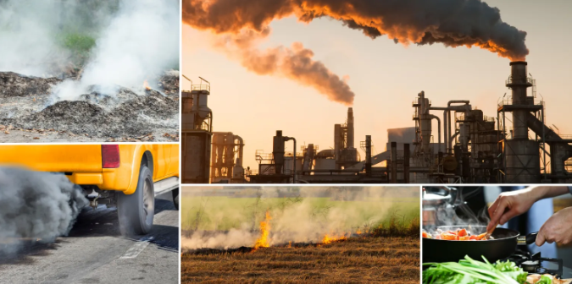
1)Air pollution
Air pollution is contamination of the indoor or outdoor environment by any chemical, physical or biological agent that modifies the natural characteristics of the atmosphere.
Pollution Effect and Solution

Slide 6
The following are some of the sectors:
Transportation: This sector (roadways, railways, airways, and marine transport) is a significant source of air pollution. The burning of different types of fuels in internal combustion engines releases pollutants such as black carbon (BC), nitrogen oxides (NOx), sulphur dioxide (SO2), particulate matter (PM), carbon monoxide (CO).
Energy production and industrial processes: Power plants that burn fossil fuels for electricity generation, as well as various industrial activities, such as manufacturing, chemical production, mining, and construction.
Residential and commercial emissions: Burning of wood and cow dung and the use of diesel generator sets for heating, cooking, and energy needs can have adverse effects on air quality.
Agricultural activities: Unscientific agricultural practices can release various pollutants into the air, mainly through livestock, crop burning, and the use of fertilizers and pesticides.
Dust and solid waste burning: Dust, particularly road dust, resuspended dust by vehicular movement, construction dust, and wind erosion.
Pollution Effect and Solution

Slide 7
Solutions
The most basic solution to air pollution is to move away from fossil fuels and replace them with alternative energies like solar, wind, and geothermal.
Use less energy: Turn off lights, computers, and appliances when you're not using them. Use energy efficient bulbs.
Reduce your consumption: Drive your car less.
Use cleaner fuels: Use clean fuels such as LPG and CNG instead of diesel and petrol.
Plant trees: Trees filter the air and provide shade.
Reduce fire use: Don't burn your garbage.
Pollution Effect and Solution

Slide 8
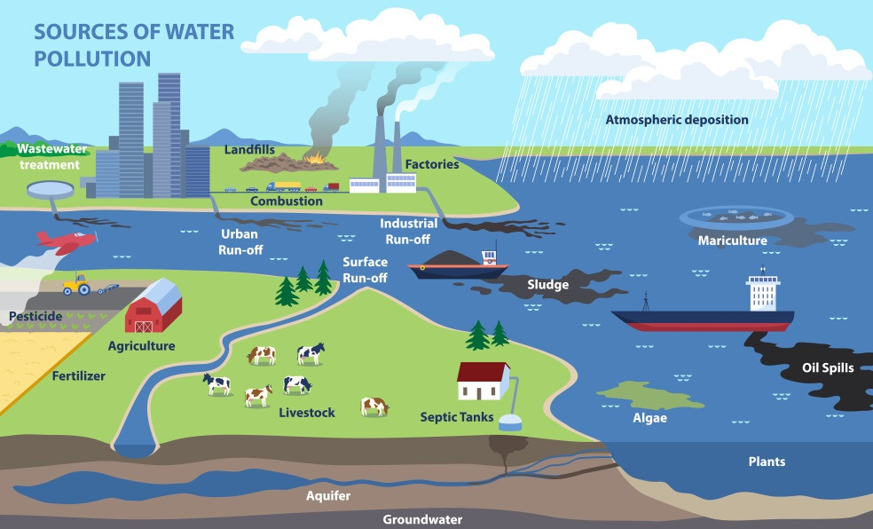
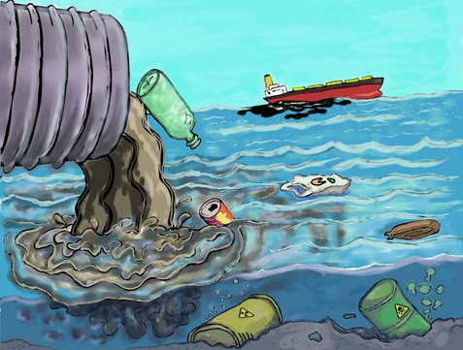
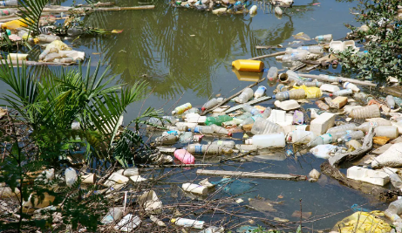
Water pollution
Water pollution occurs when harmful substances—often chemicals or microorganisms—Effect a stream, river, lake, ocean, or other body of water, degrading water quality and rendering it toxic to humans or the environment.
Pollution Effect and Solution

Slide 9
The following are some of the sectors:
Industrial Pollution: This includes the discharge of pollutants from manufacturing processes, chemical plants, power plants, and other industrial activities. Pollutants may include heavy metals, chemicals, organic compounds, and thermal pollution (increased water temperature).
Agricultural Pollution: Agricultural activities such as the use of fertilizers, pesticides, and herbicides can lead to water pollution. Runoff from farms can carry excess nutrients like nitrogen and phosphorus, as well as pesticides, into water bodies, causing eutrophication and harming aquatic life.
Mining Pollution: Mining activities can introduce various pollutants into water bodies, including heavy metals, sediment, and acidic drainage (acid mine drainage). These pollutants can have significant adverse effects on aquatic ecosystems and water quality.
Plastic Pollution: The accumulation of plastic debris in water bodies, such as rivers, lakes, and oceans, is a growing concern. Plastic pollution harms aquatic life through ingestion, entanglement, and the release of toxic chemicals.
Pollution Effect and Solution

Slide 10
Solutions
Water conservation: Install water-efficient showerheads (2.5 gallons or less per minute). Take short showers and use low flow toilets (1.6 gallons or less per flush).
Reduce plastic waste
Green agriculture: Use manure or compost instead of commercial inorganic fertilizer. Use native plants that require less water.
Properly dispose of waste: Don't pour pesticides, paints, solvents, oil, antifreeze, or other harmful chemicals down the drain or onto the ground.
Wastewater treatment: it removes rags and suspended solids, suspended and dissolved organics, nutrients, and pathogens.
Pollution Effect and Solution

Slide 11
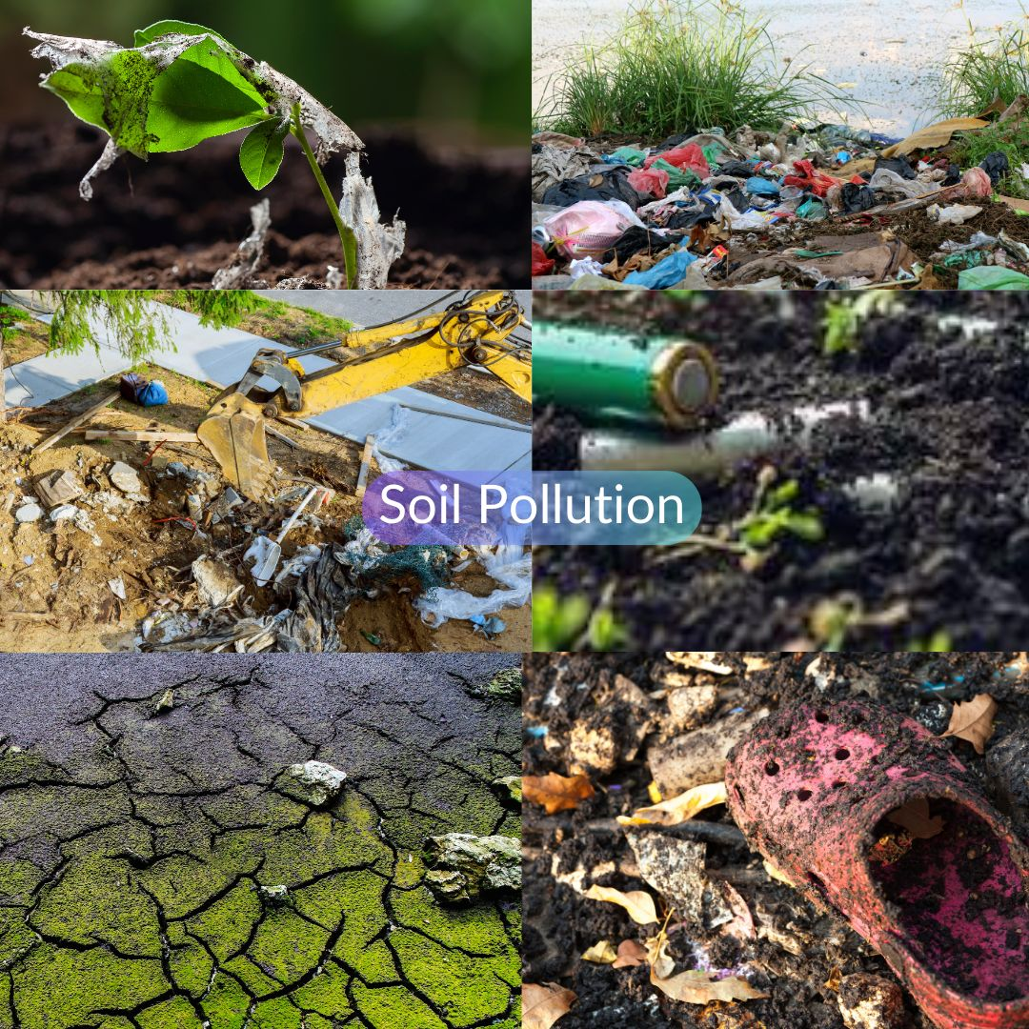
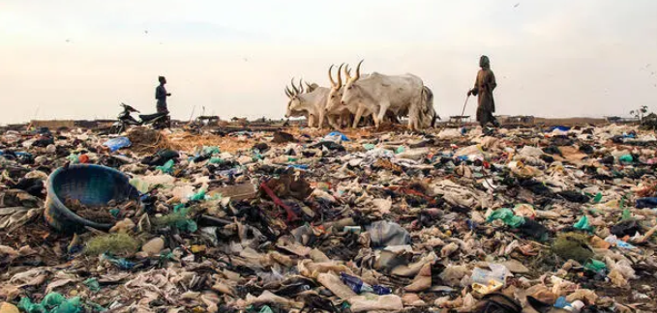
Soil Pollution
Soil pollution, or land pollution as a part of land degradation is caused by the presence of xenobiotic chemicals or other alteration in the natural soil environment. It is typically caused by industrial activity, agricultural chemicals or improper disposal of waste.
Pollution Effect and Solution

Slide 12
Causes and types of soil pollution
Industrial waste: Chemicals released into the environment by industries in liquid or solid form
Deforestation: Exposes soil to the elements, making it susceptible to erosion
Excessive use of fertilizers and pesticides: Can harm soil microorganisms and reduce soil fertility
Garbage pollution: Throwing garbage on soil, releasing plastic waste, and using chemical fertilizers
Climate change: Can impact soil fertility
Mining activities: Can erode soil
Urban infrastructural activities: Can lead to dumping of solid waste in the soil
Acid rain: Causes the deposition of nitrogen and sulfur oxides into the soil, which can weaken plants by dissolving nutrients
Pollution Effect and Solution

Slide 13
Solution
Use fewer chemicals
Use organic fertilizers instead of chemical fertilizers and pesticides, and reduce the use of pesticides.
Reduce waste
Recycle and reuse products, and properly dispose of household and industrial waste.
Plant more trees
Plant trees and grass to prevent erosion, and add mulch or rocks to weigh down the soil and protect young plants.
Eat less meat
Eat sustainable food, and purchase local and organic fruits and vegetables.
Improve farming practices
Use correct farming techniques, crop rotation, and integrated pest control methods.
Pollution Effect and Solution

Slide 14
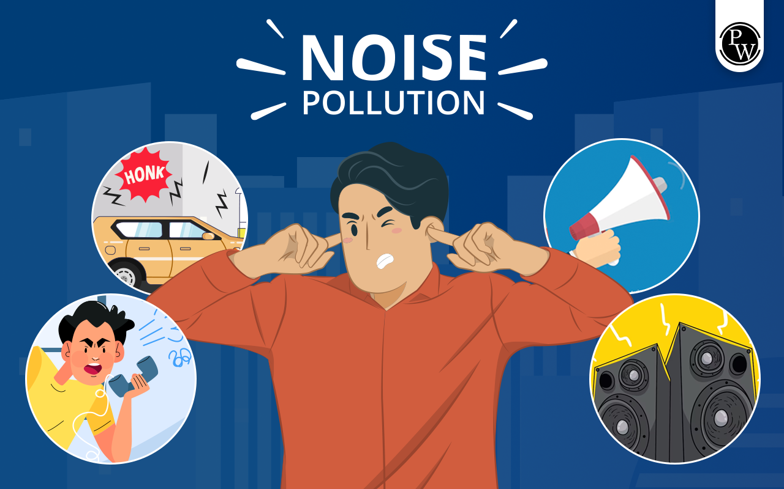
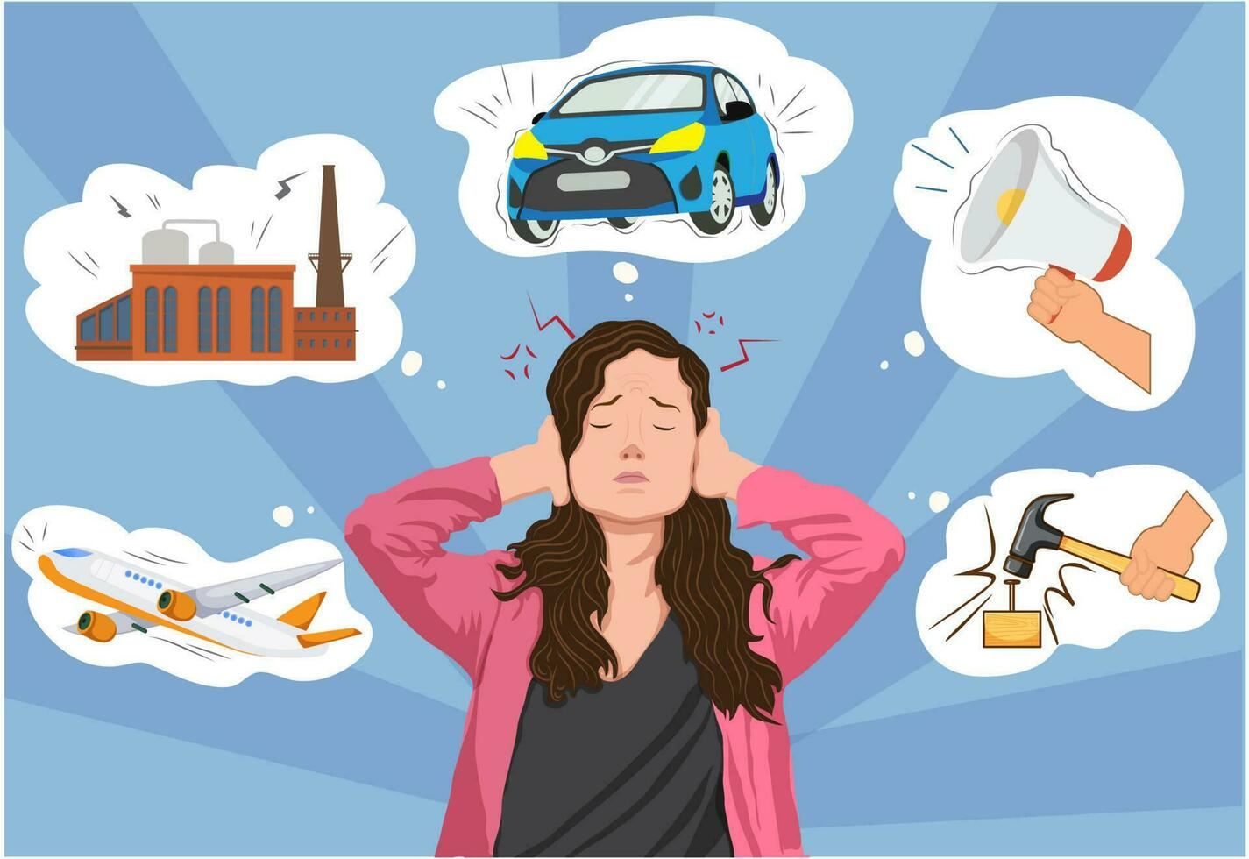
Noise Pollution
Noise pollution, or sound pollution, is the propagation of noise or sound with ranging impacts on the activity of human or animal life, most of which are harmful to a degree. The source of outdoor noise worldwide is mainly caused by machines, transport and propagation systems
Pollution Effect and Solution

Slide 15
Causes of Noise pollution
Industrial Causes: Industries, mills, and factories produce high-intensity sound and these sounds are the major causes of industrial noise pollution. Industrial noise pollution can be caused by textile mills, engineering companies, and printing presses.
Household Utilities: Household noise pollution can also be caused by electrical devices like televisions telephones, radios, transistors, loudspeakers, musical instruments, house renovations ,etc.
Transportation :Transportation Noise Pollution can be caused by traffic, trains and aircraft, scooters, motorcycles, trucks, buses, cars, and its rapidly increasing number.
Social Events: This includes concerts, parties, worship places, discos, etc. Loud sounds from social events are mainly known as a ‘nuisance’ that can affect the sleeping cycle of the person.
Defense Machinery: It includes military tanks, shooting practices, military airplane training, explosions, and rocket launching that affect the environment badly.
Pollution Effect and Solution

Slide 16
Solutions
Turn off appliances: Turn off appliances like TVs, computers, and games when not in use.
Lower the volume: Lower the volume of TVs, smartphones, and other electrical appliances.
Use headphones: Use headphones or earphones when listening to music or watching videos on your phone.
Close doors and windows: Close doors and windows when using noisy machines.
Plant trees: Plant trees and shrubs to cut sound and reduce noise pollution.
At event or party time use hall or do not use high volume.
Pollution Effect and Solution

Slide 17
Conclusion
Environmental pollution is proved to be a major threat and their effects have various effects on living organisms including risks in plants. In most cases, pollutants change the plant growth, development, physiological, biochemical and metabolic, defense, and immunity pathways.
Pollution Effect and Solution

Slide 18


